Slide 1

Shipment Analysis
Data Analytics Project
By Anushree Badole | October 17, 2025
Notes:
1

Slide 2
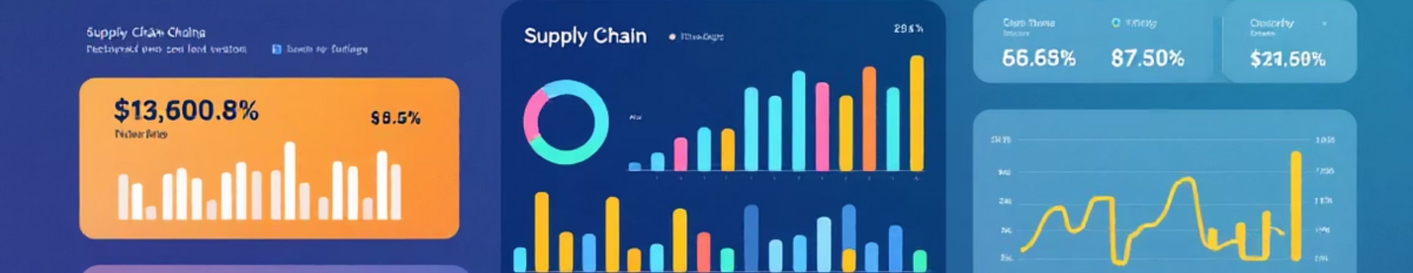
Project Objective
Conduct comprehensive analysis of shipment data to uncover operational trends, identify cost inefficiencies, and enhance decision-making through data-driven insights. This project involves cleaning, transforming, and standardizing datasets to ensure analytical accuracy while optimizing logistics operations, improving cost efficiency, and supporting overall supply chain performance.
Notes:
2

Slide 3
Dataset Overview
Our analysis examines five critical variables that shape logistics performance:
Logistics Provider
Source & Destination
Transport Mode
Company responsible for shipment handling
Starting and delivery points
Air, Sea, Road, or Rail
Shipment Cost
Delivery Delay
Complete cost in Rs.
Hours between expected and actual delivery
Notes:
3

Slide 4

Exploratory Data Analysis
1
Data Cleaning
Handled missing values, corrected data types, removed duplicates, and standardized date fields for consistency and reliability.
2
Univariate Analysis
Examined individual variables using histograms, boxplots, and summary statistics to understand cost, distance, and delay distributions.
Bivariate & Multivariate Analysis
3
Explored relationships between variables using scatter plots, boxplots, and correlation matrices to identify key dependencies.
Notes:
4

Slide 5

Feature Engineering
Creating new variables from existing data to improve analysis and model performance:
Derived Metrics
Encoding & Transformation
Cost per km = Shipment Cost ÷ Distance
Binary flags for delayed shipments
Cost per kg = Shipment Cost ÷ Package Weight
Interaction features combining fragility and value
Delay Category = Low, Medium, High classification
One-Hot Encoding for categorical variables
Standardization for numerical consistency
Notes:
5

Slide 6

Outlier Treatment & Data Refinement
IQR Method Detection
Capping Strategy
Identified extreme values in Total Cost using Interquartile Range methodology to flag statistical outliers accurately.
Replaced outliers with nearest valid values to preserve data integrity while eliminating erroneous extreme points.
Improved Reliability
Refined dataset ensures more accurate analysis, consistent insights, and dependable predictive modeling for supply chain decisions.
Notes:
6

Slide 7
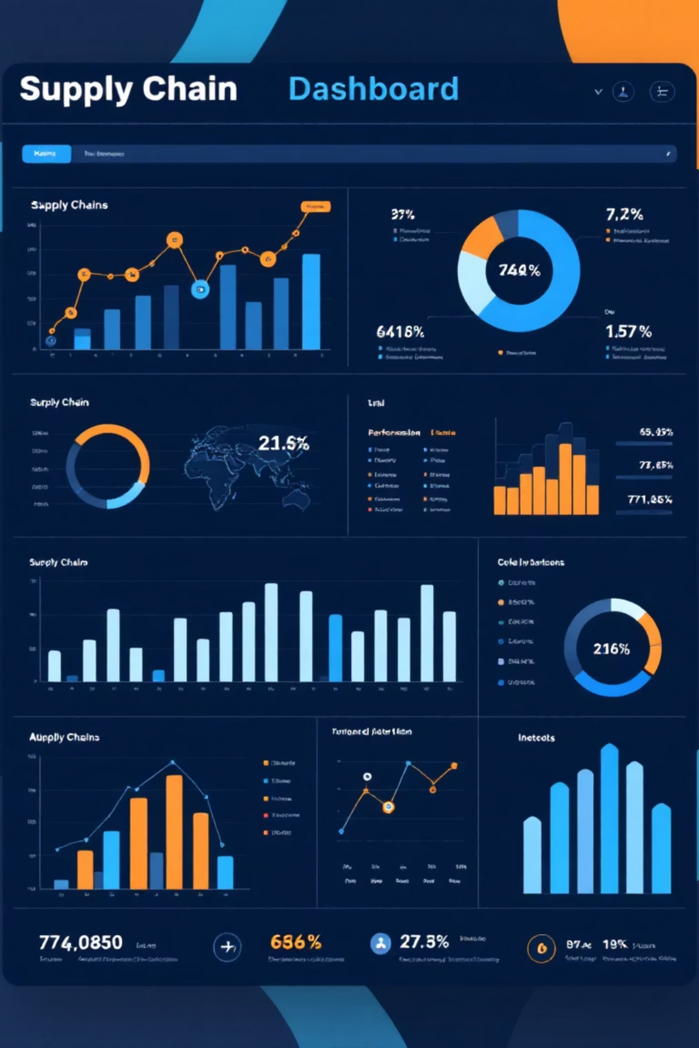

Business Analysis & Key Insights
Shipment Cost by Company
Compared average costs across providers to identify the most cost-efficient logistics partner and optimize vendor selection.
Delays by Transport Mode
Analyzed which mode—Air, Sea, Road, or Rail—faces highest delays to improve routing and scheduling strategies.
Regional Cost Analysis
Visualized total shipment costs across source and destination regions to identify high-cost corridors and optimization opportunities.
Returns & Delays by Category
Highlighted product categories with elevated delays or returns to guide inventory, packaging, and handling improvements.
Strategic Outcome: Identified cost drivers, delay patterns, and improvement areas to enhance supply chain efficiency and reduce operational expenses.
Notes:
7

